Slide 1
ELE419
IC Design Project
Physical VLSI Design of 8-bit ALU with Extended Opcode Set
BETÜL ATALAY
2210357078

Slide 2
Literature Review
For the shift operations in a transistor-level (CMOS) ALU, the “just wire it” approach that is common in HDL is not sufficient, because the shift must be selectable by opcode and must drive a real load without creating contention. In CMOS, a controlled shift is typically implemented using a multiplexer network / barrel shifter, or with transmission gates plus inverters/buffers to restore logic levels, manage fan-out, and prevent floating nodes. Also, LTspice is an analog SPICE simulator, so it does not provide a built-in “shift operator” like a digital HDL; therefore, the shift function must be realized structurally (MUX/TG/buffers) rather than by an abstract operator. In my design, I implemented all logical and arithmetic shifts using buffer-driven, opcode-controlled routing, so the shifted outputs are full-swing and robust for the next stages of the ALU. [1], [2], [3].

Slide 3
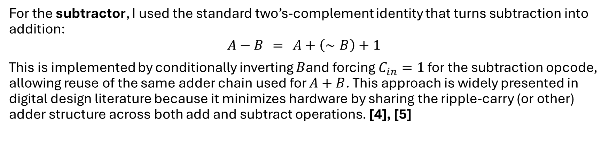
Literature Review
For the subtractor, I used the standard two’s-complement identity that turns subtraction into addition:
$$A−B = A+\left(∼B\right)+1$$
This is implemented by conditionally inverting $B$and forcing $C_{in}=1$ for the subtraction opcode, allowing reuse of the same adder chain used for $A+B$. This approach is widely presented in digital design literature because it minimizes hardware by sharing the ripple-carry (or other) adder structure across both add and subtract operations. [4], [5]

Slide 4
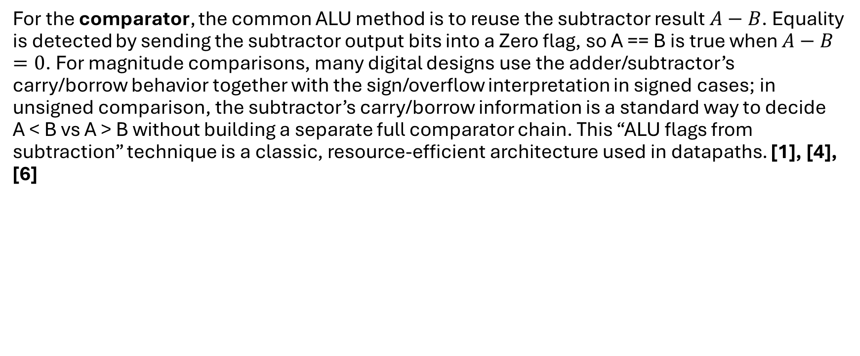
Literature Review
For the comparator, the common ALU method is to reuse the subtractor result $A−B$. Equality is detected by sending the subtractor output bits into a Zero flag, so A == B is true when $A−B=0$. For magnitude comparisons, many digital designs use the adder/subtractor’s carry/borrow behavior together with the sign/overflow interpretation in signed cases; in unsigned comparison, the subtractor’s carry/borrow information is a standard way to decide A < B vs A > B without building a separate full comparator chain. This “ALU flags from subtraction” technique is a classic, resource-efficient architecture used in datapaths. [1], [4], [6]

Slide 5
Literature Review
During this project, I also used a YouTube tutorial as a practical reference to understand CMOS gate-level behavior (pull-up/pull-down networks) and to validate my intuition while building the fundamental blocks. Specifically, I designed my 1-bit NAND, inverter, NOR, and XOR blocks by following the CMOS logic principles demonstrated in that tutorial; the content helped me internalize how transistor networks realize Boolean functions and gave me a clear “design vision” that guided my later, more complex modules .[7]

Slide 6
Literature Review
[1] N. H. E. Weste and D. Harris, CMOS VLSI Design: A Circuits and Systems Perspective, 4th ed. Boston, MA, USA: Addison-Wesley, 2011.
[2] J. M. Rabaey, A. Chandrakasan, and B. Nikolić, Digital Integrated Circuits: A Design Perspective, 2nd ed. Upper Saddle River, NJ, USA: Prentice Hall, 2003.
[3] R. J. Baker, CMOS: Circuit Design, Layout, and Simulation, 3rd ed. Hoboken, NJ, USA: Wiley-IEEE Press, 2010.
[4] M. M. Mano and M. D. Ciletti, Digital Design: With an Introduction to the Verilog HDL, VHDL, and SystemVerilog, 6th ed. Boston, MA, USA: Pearson, 2018.
[5] D. M. Harris and S. L. Harris, Digital Design and Computer Architecture, 2nd ed. Waltham, MA, USA: Morgan Kaufmann, 2012.
[6] J. L. Hennessy and D. A. Patterson, Computer Architecture: A Quantitative Approach, 5th ed. Burlington, MA, USA: Morgan Kaufmann, 2011.
[7] YouTube Tutorial, “CMOS Logic Gates Explained + NAND, NOR, XOR Implementation,” YouTube. Accessed: Jan. 2026. [Online]. Available: https://www.youtube.com/watch?v=MupsaVTT6iw

Slide 7
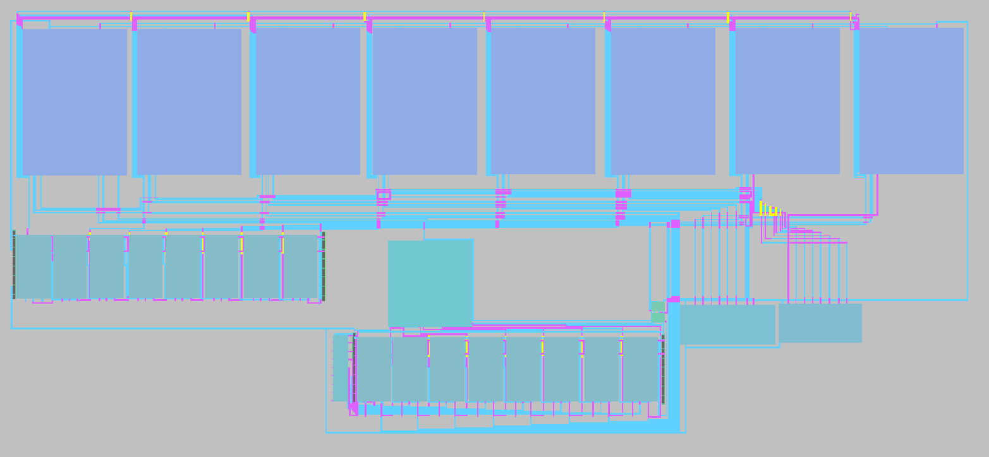
Physical Layout of the Complete Design

Slide 8
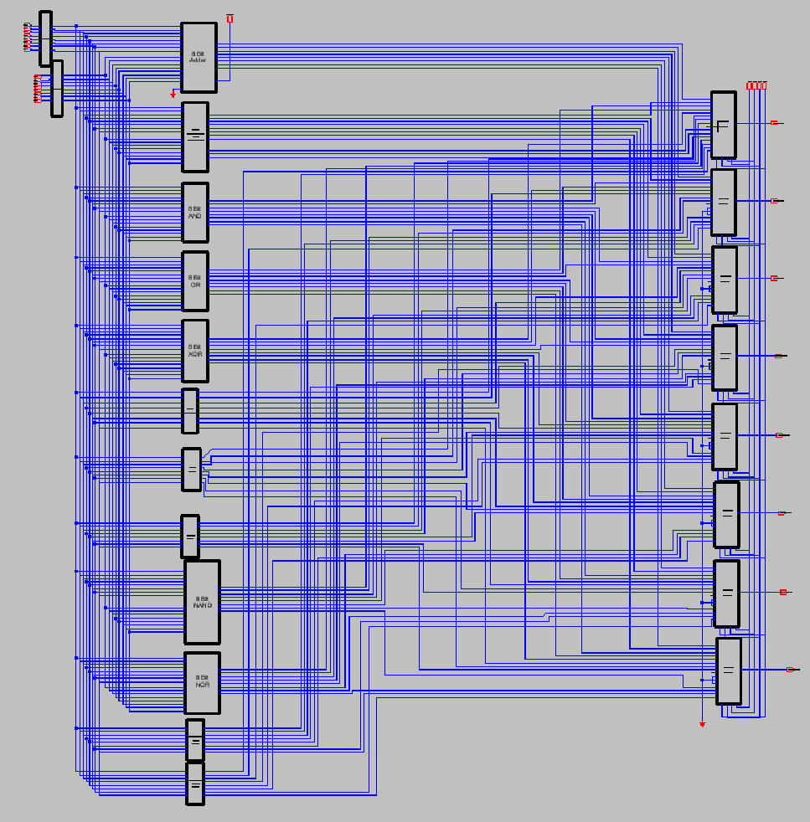
Additional Design Material
The multiplication unit requires significantly higher hardware complexity compared to the other ALU operations. For this reason, the design effort was focused on the complete and correct implementation of the remaining fifteen operations. Each operation was individually designed as an 8-bit functional block, and all blocks were subsequently integrated into a unified schematic representing the overall ALU architecture.
Although the full physical layout of the entire system could not be completed within the project timeframe due to layout complexity and time limitations, the complete functional behavior of the ALU was successfully implemented and verified at the schematic level as shown in the schematic on the right.

Slide 9
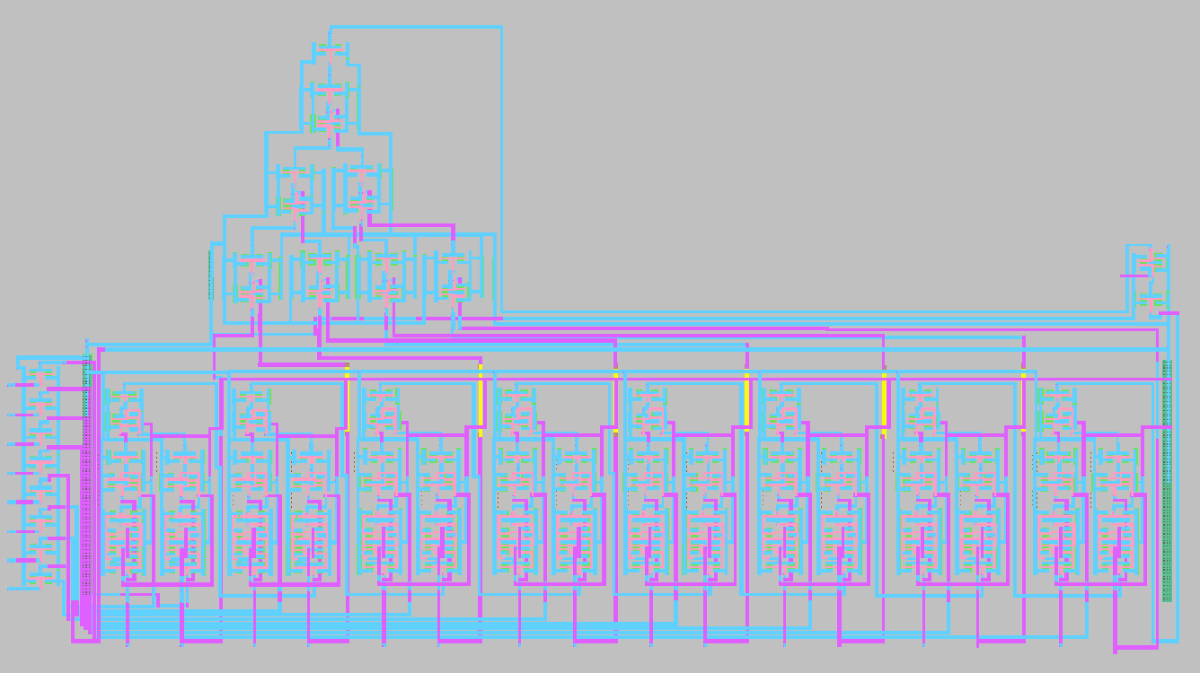
Additional Design Material
8-Bit Subtractor with Zero Flag, Equal, Less Than and Greater Than Comparators
It also includes the 8-Bit Adder layout.

Slide 10
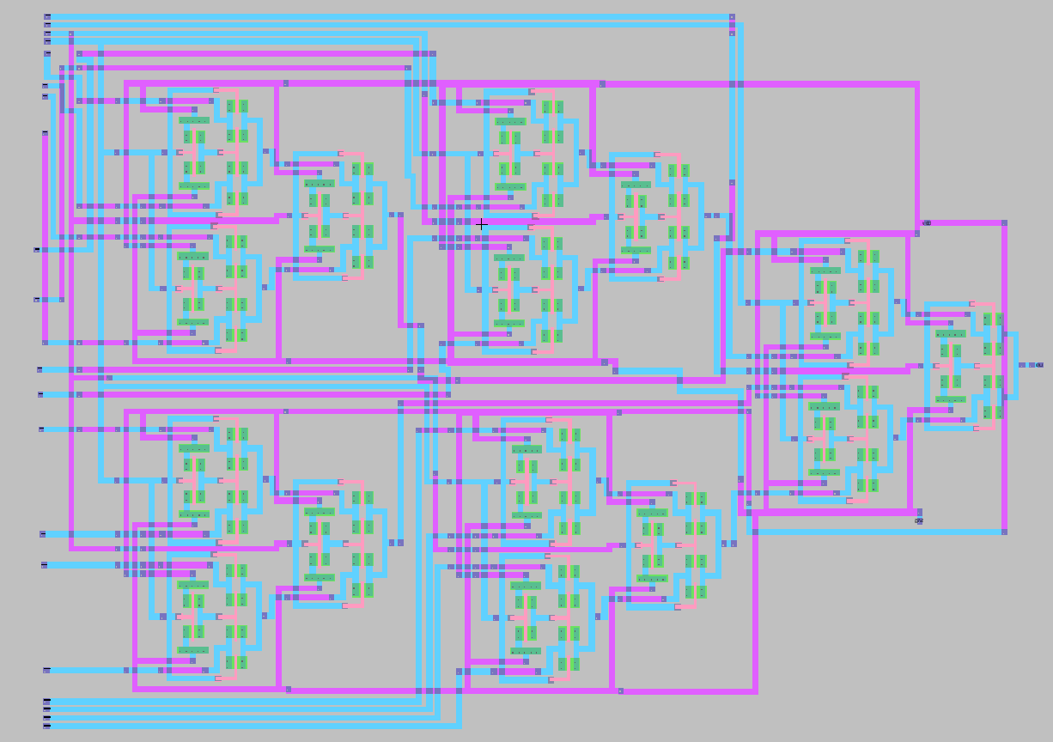
Additional Design Material
16:1 MUX Layout with Transmission Gates and using 2:1 MUXs as a Fundamental Block

Slide 11
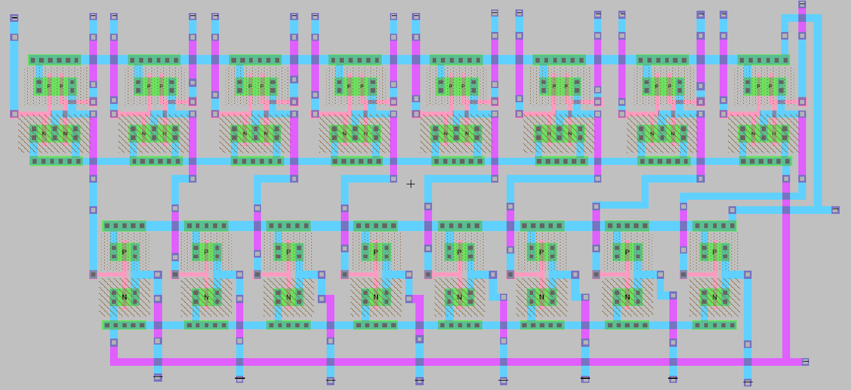
Additional Design Material
8-Bit OR Layout

Slide 12
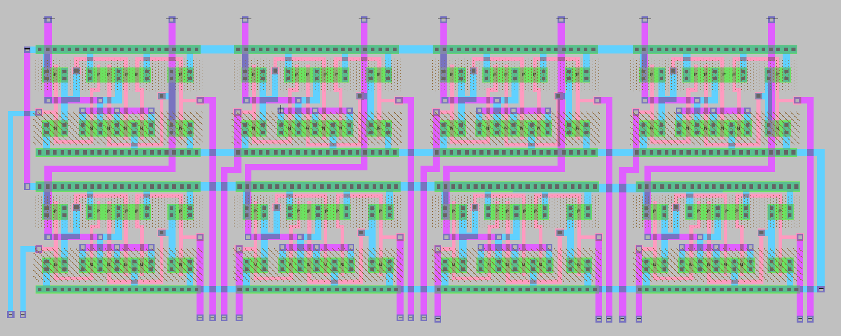
Additional Design Material
8-Bit XOR Layout

Slide 13
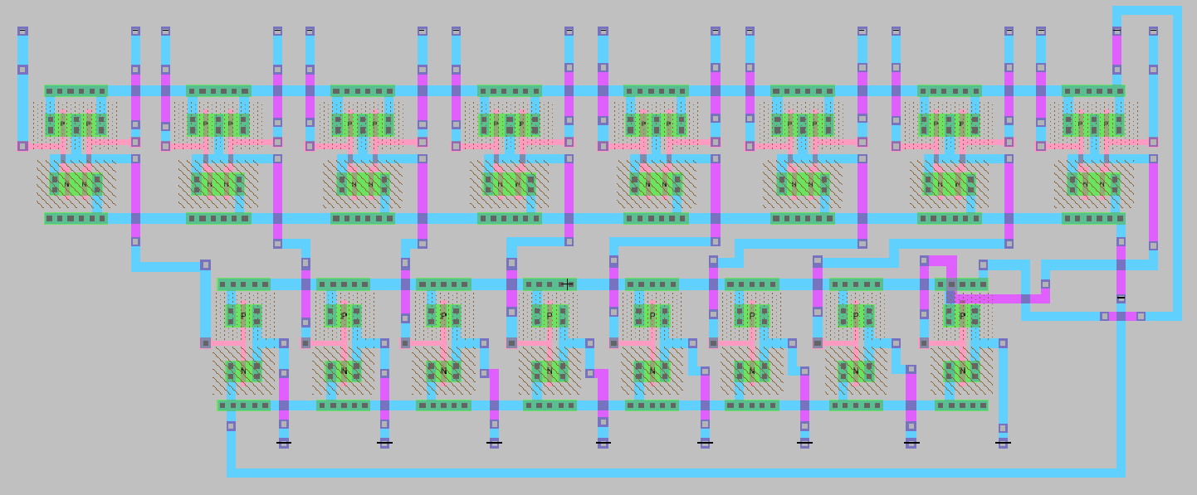
Additional Design Material
8-Bit AND Layout

Slide 14
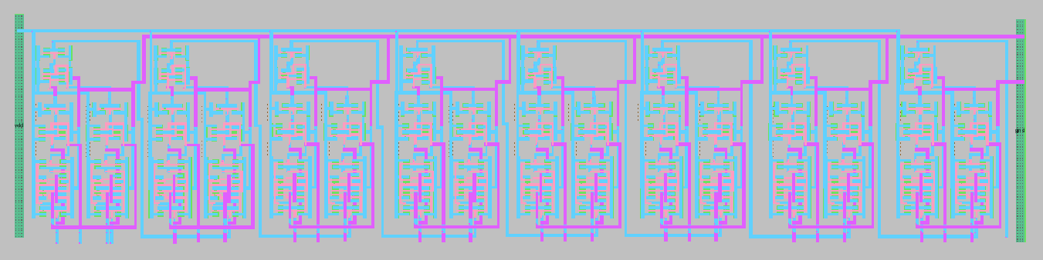
Additional Design Material
8-Bit Adder Layout

Slide 15
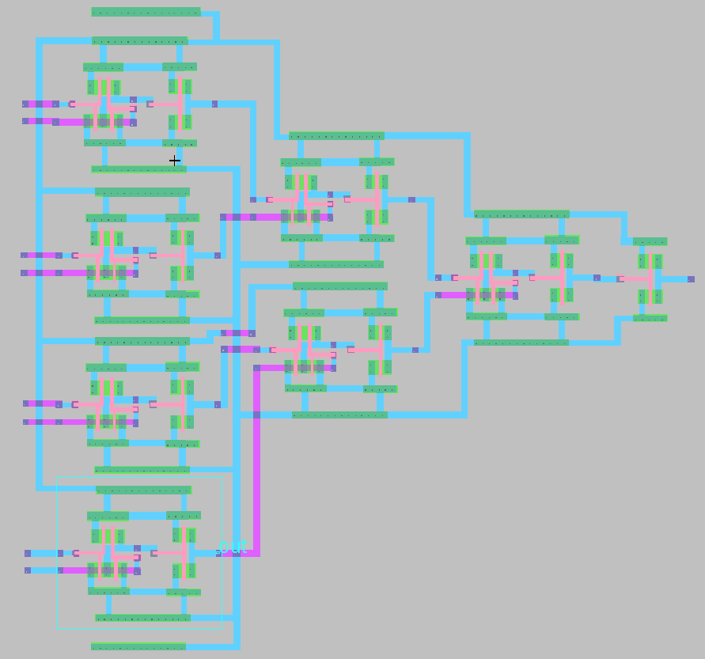
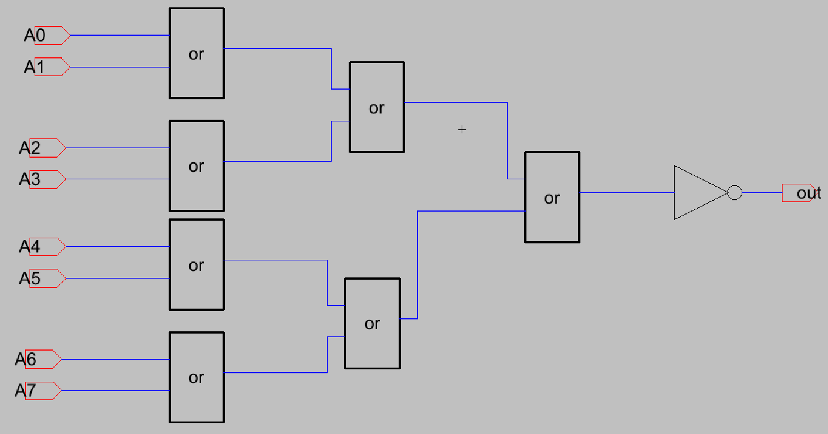
Additional Design Material
Zero Flag Schematic and Layout Using OR Gates

Slide 16
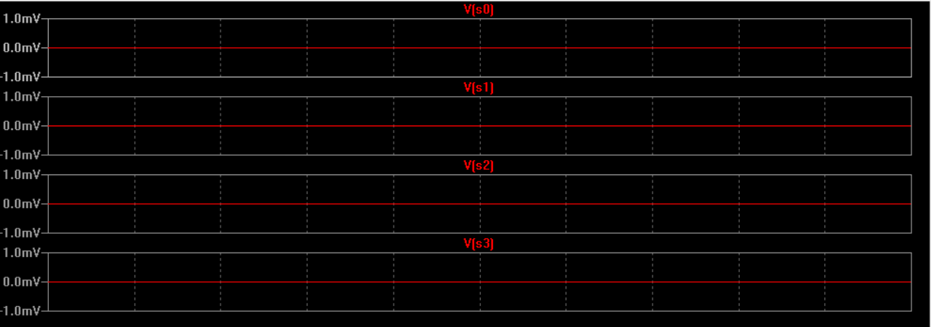
Demonstration of Addition
A = 01010101
B = 01001110
Opcode | Operation | Expected Answer | Result of the simulation
0000 | A + B | 10100011 | 10100011

Slide 17
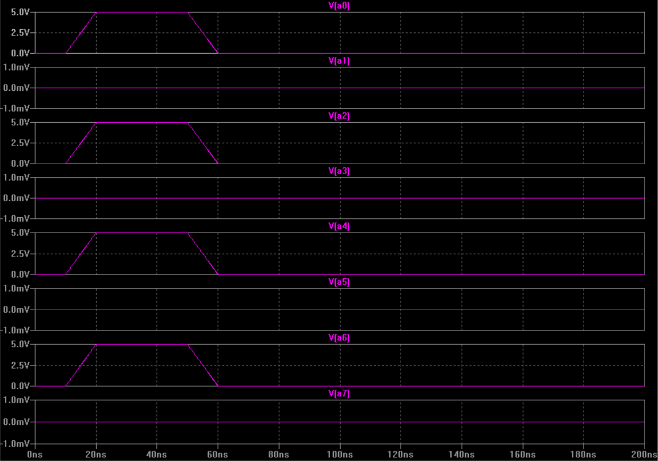
Demonstration of Addition
A = 01010101
B = 01001110
INPUT A

Slide 18
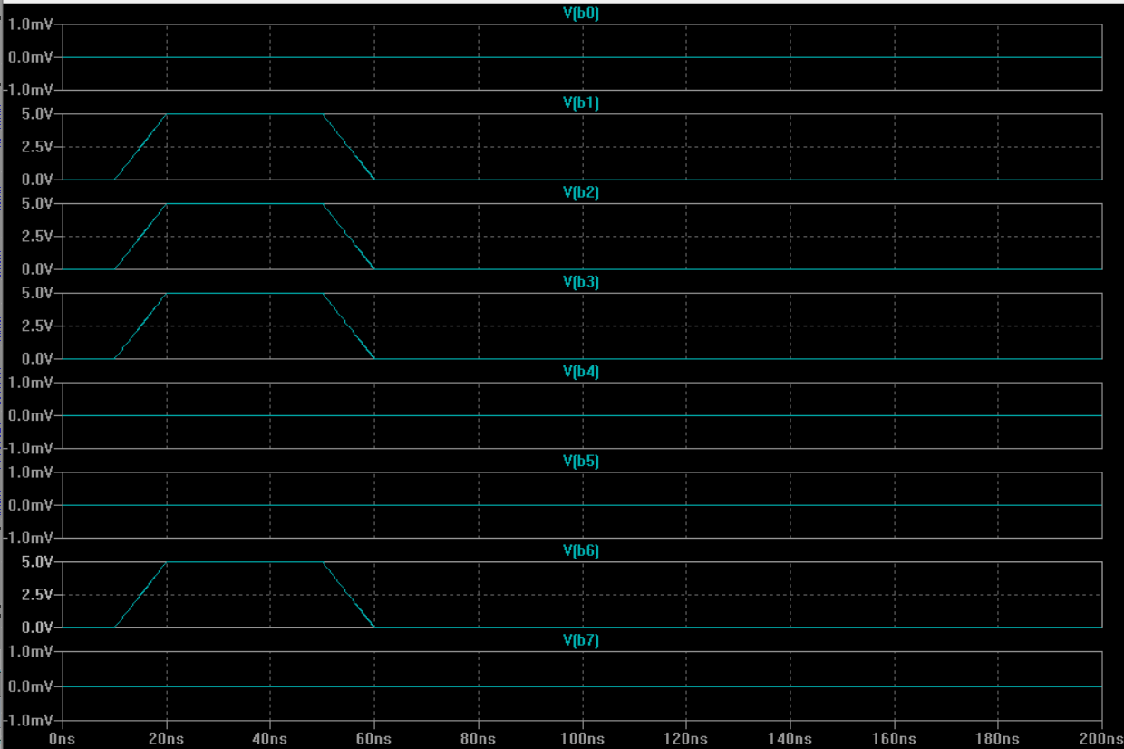
Demonstration of Addition
A = 01010101
B = 01001110
INPUT B

Slide 19
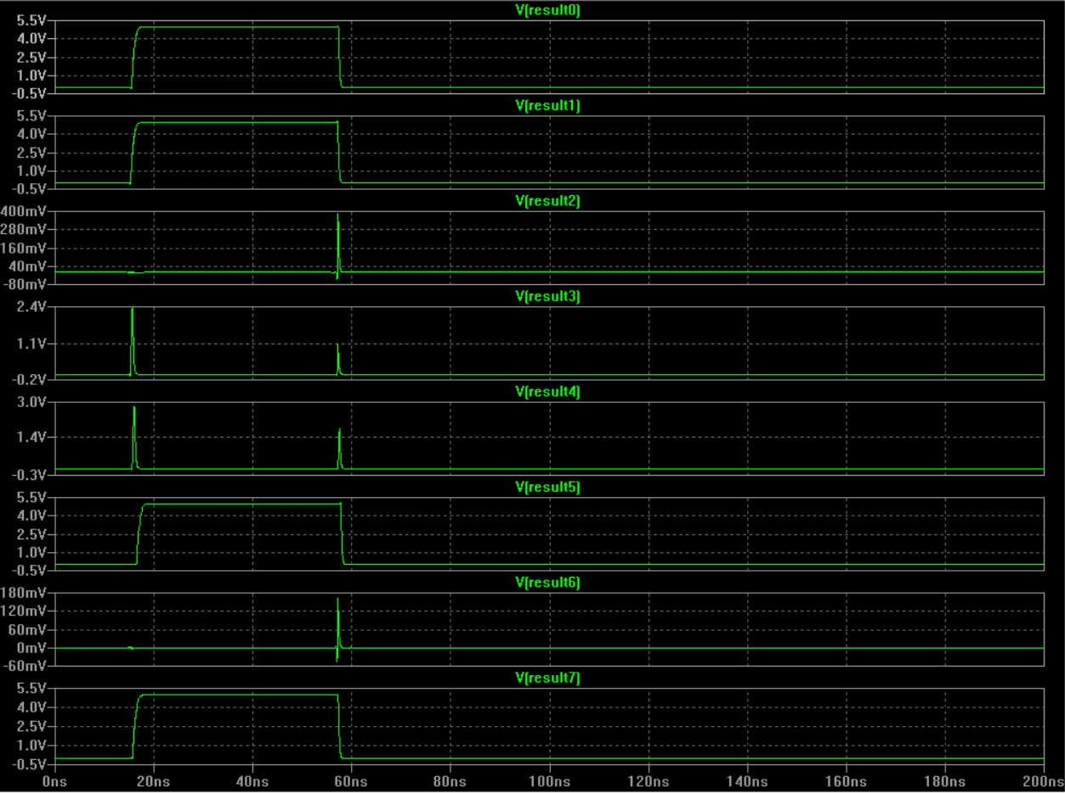
Demonstration of Addition
A = 01010101
B = 01001110
Opcode | Operation | Expected Answer | Result of the simulation
0000 | A + B | 10100011 | 10100011
The simulation verifies the correct functionality of the 8-bit adder block.
Result0 refers LSB and Result7 refers MSB.

Slide 20
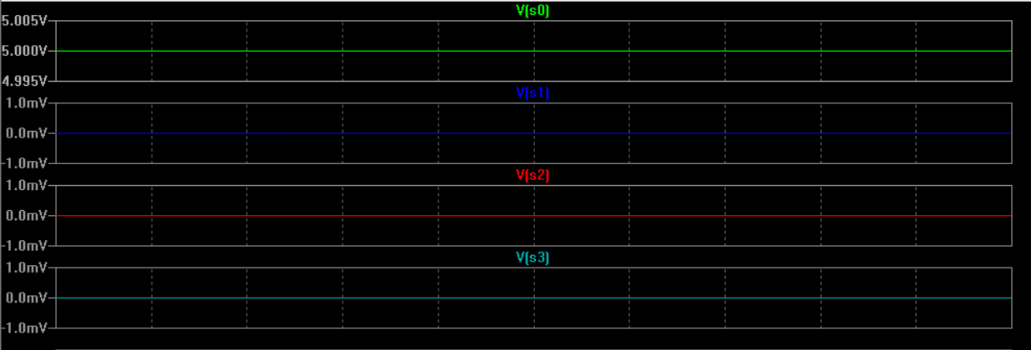
Demonstration of Subtraction
Last 2 digit of my Student ID in binary => A = 01001110
B = 1
Opcode | Operation | Expected Answer | Result of the simulation
0001 | A - B | 01001101 | 01001101

Slide 21
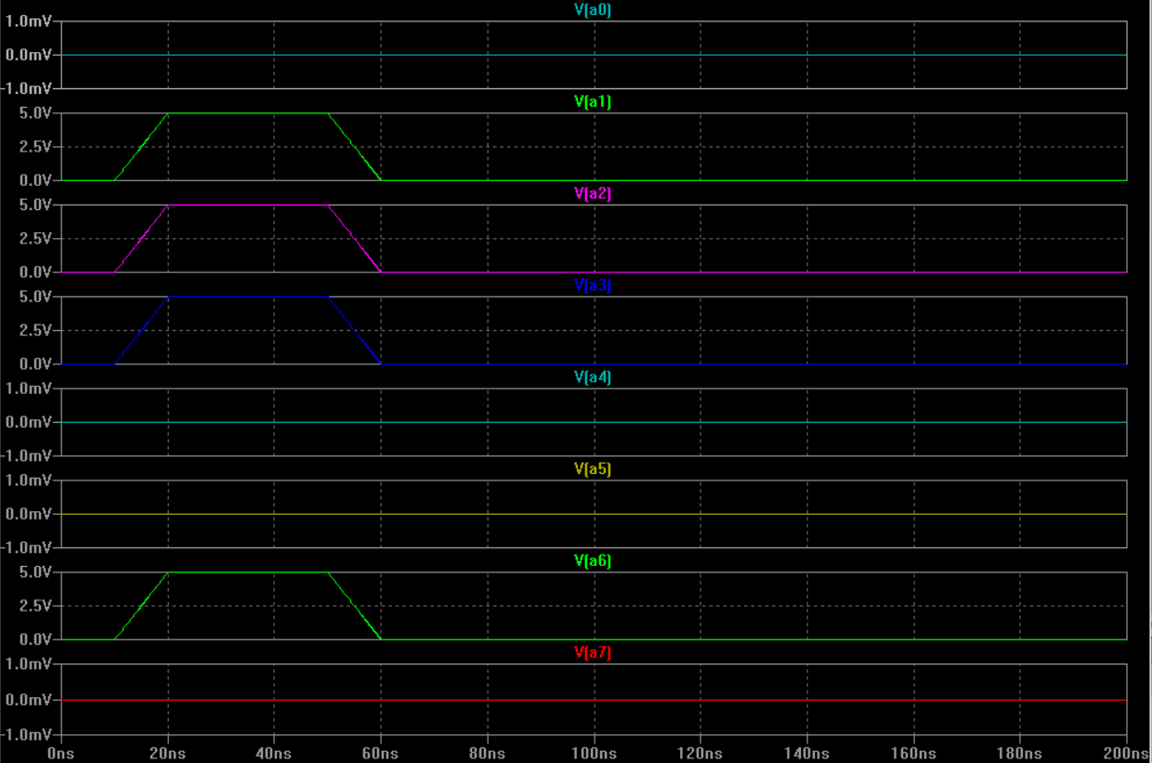
Demonstration of Subtraction
Last 2 digit of my Student ID in binary => A = 01001110
B = 1
INPUT A

Slide 22
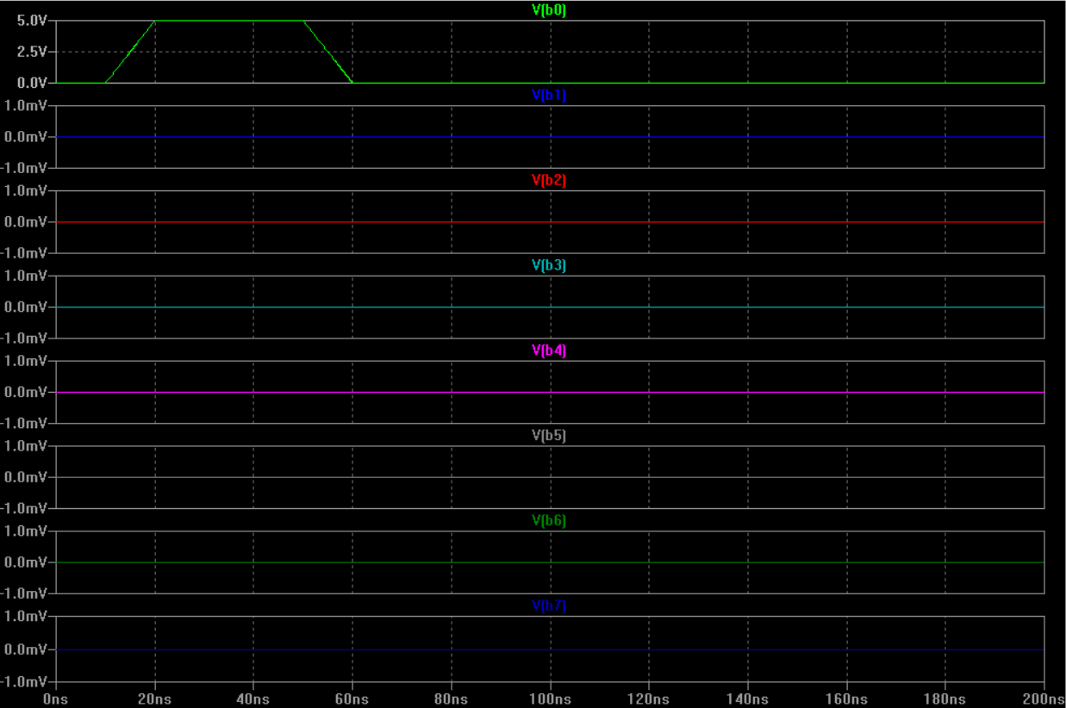
Demonstration of Subtraction
Last 2 digit of my Student ID in binary => A = 01001110
B = 1
INPUT B

Slide 23
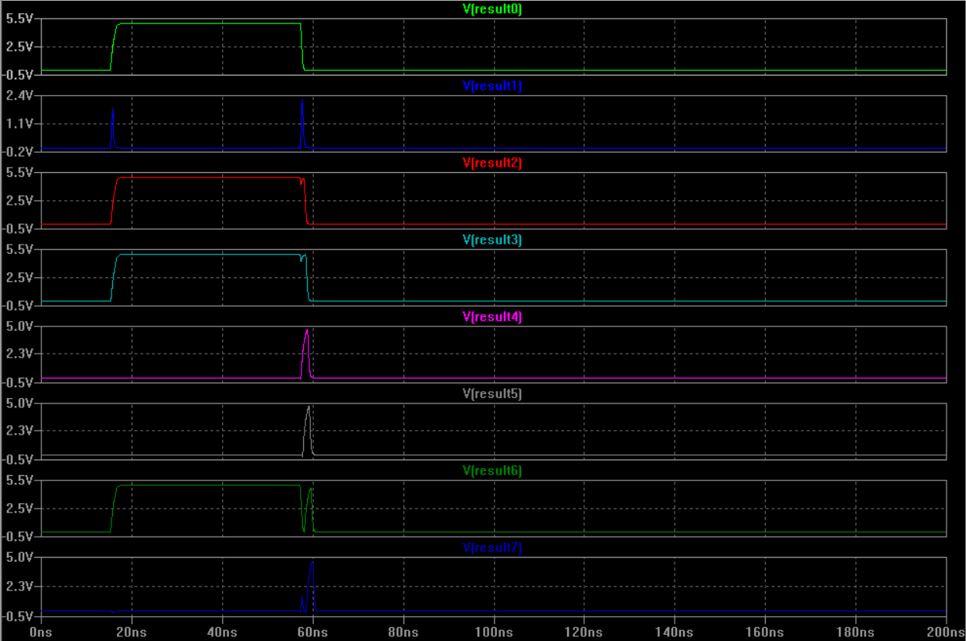
Demonstration of Subtraction
Last 2 digit of my Student ID in binary => A = 01001110
B = 1
Opcode | Operation | Expected Answer | Result of the simulation
0001 | A - B | 01001101 | 01001101
The waveform shows stable and clean transitions, indicating correct subtractor functionality.

Slide 24
Demonstration of “Multiplication”
Last 2 digit of you Student ID in binary x 10101=?
Opcode | Operation | Expected Answer | Result of the simulation
1000 | A x B | ? | ?
The multiplication operation was intentionally excluded due to its higher implementation complexity, which would require additional hardware resources and significantly increase the overall design effort. The remaining ALU functions were fully implemented and verified to ensure correct operation within the project scope.

Slide 25
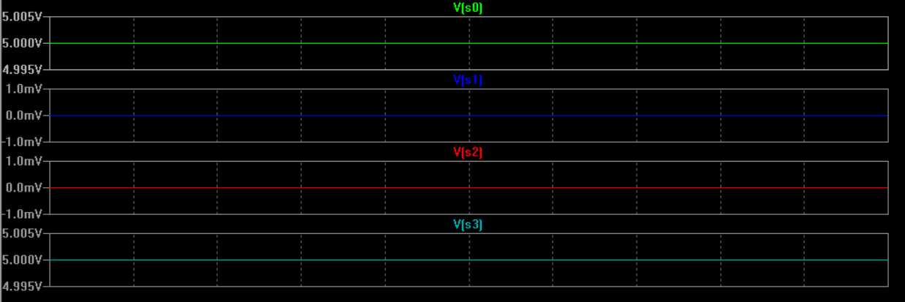
Demonstration of “Equality Check”
Last 2 digit of my Student ID in binary=> A = 01001110
B = 101
Opcode | Operation | Expected Answer | Result of the simulation
1001 | A == B | 00000000 | 00000000

Slide 26
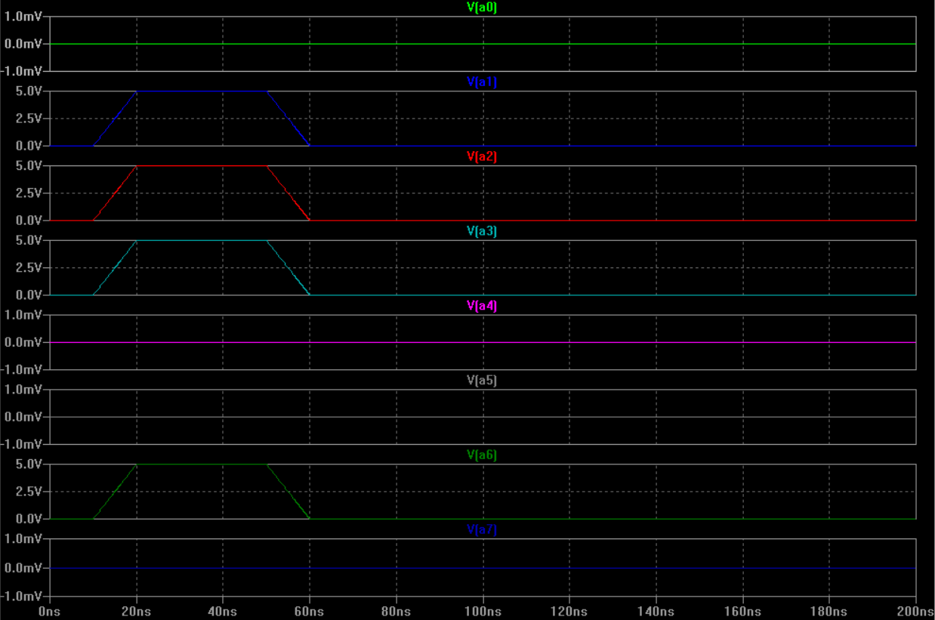
Demonstration of “Equality Check”
Last 2 digit of my Student ID in binary=> A = 01001110
B = 101
INPUT A

Slide 27
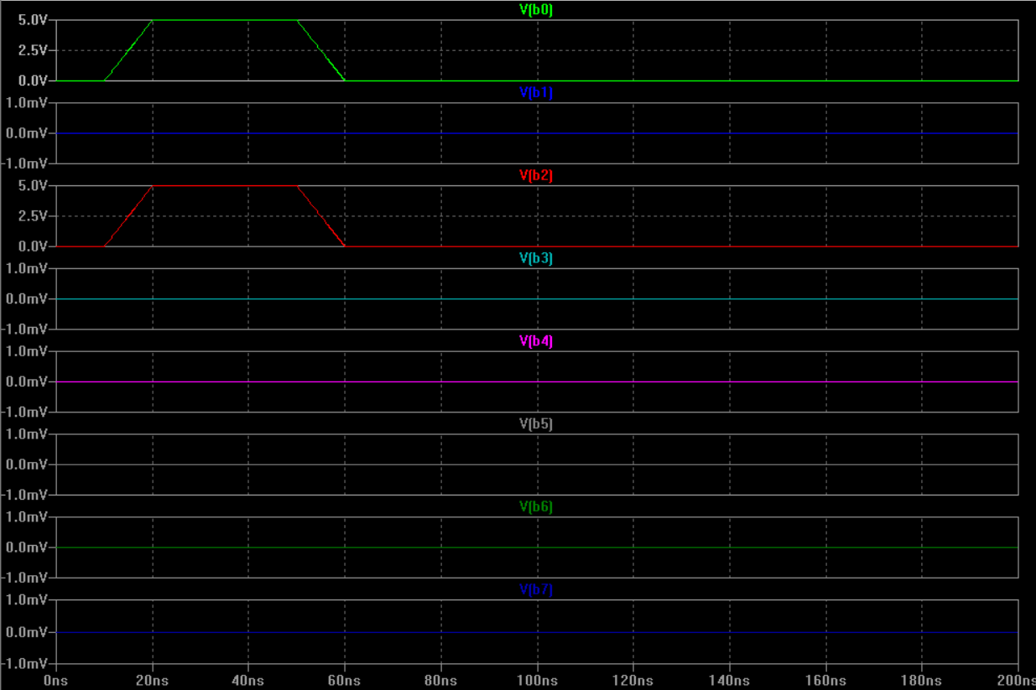
Demonstration of “Equality Check”
Last 2 digit of my Student ID in binary=> A = 01001110
B = 101
INPUT B

Slide 28
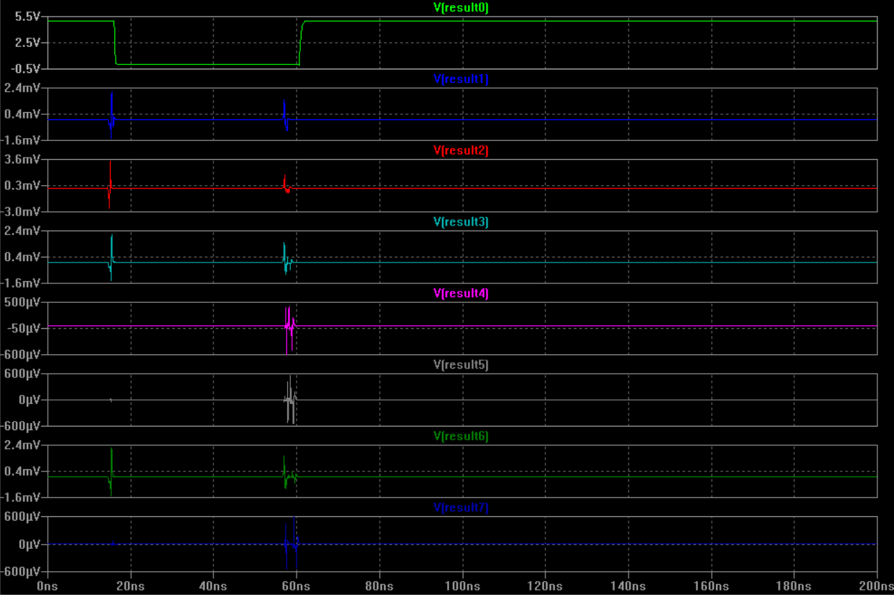
Demonstration of “Equality Check”
Last 2 digit of my Student ID in binary=> A = 01001110
B = 101
Opcode | Operation | Expected Answer | Result of the simulation
1001 | A == B | 00000000 | 00000000
The equality check is implemented by evaluating the result of the subtraction operation. When the subtraction output equals zero, the Zero Flag is asserted, indicating that the two input operands are equal. In this design, only the LSB (Result[0]) of the equality output is used for the decision, while the remaining result bits (Result[1]–Result[7]) are tied to ground for this operation.

Slide 29
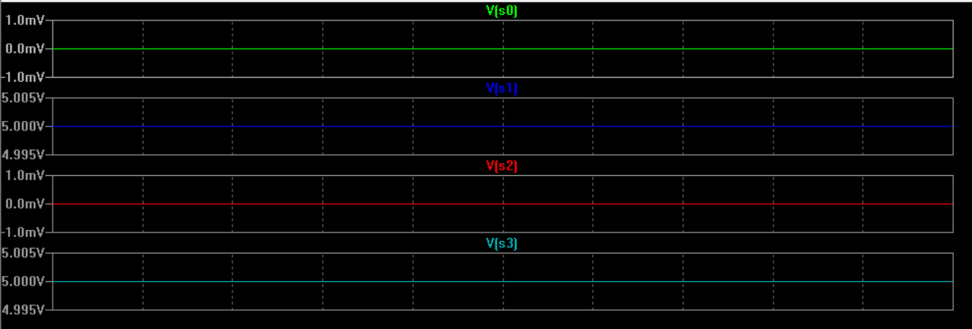
Demonstration of “Greater Than”
Last 2 digit of my Student ID in binary=> A = 01001110
B = 101
Opcode | Operation | Expected Answer | Result of the simulation
1010 | A > B | 00000001 | 00000001

Slide 30
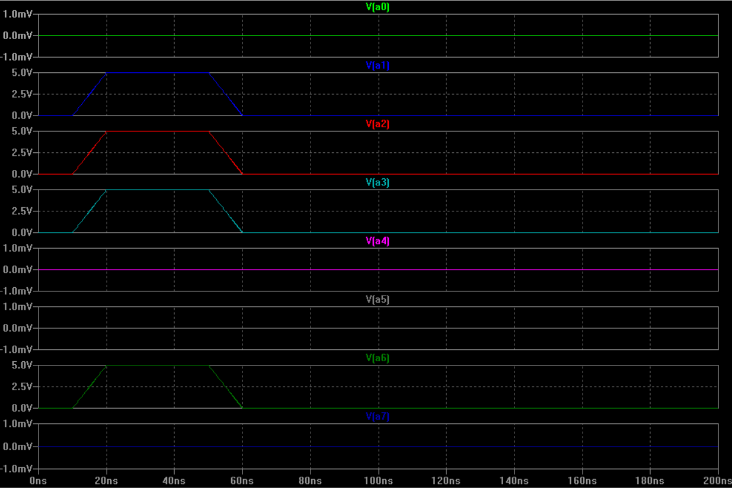
Demonstration of “Greater Than”
Last 2 digit of my Student ID in binary=> A = 01001110
B = 101
INPUT A

Slide 31
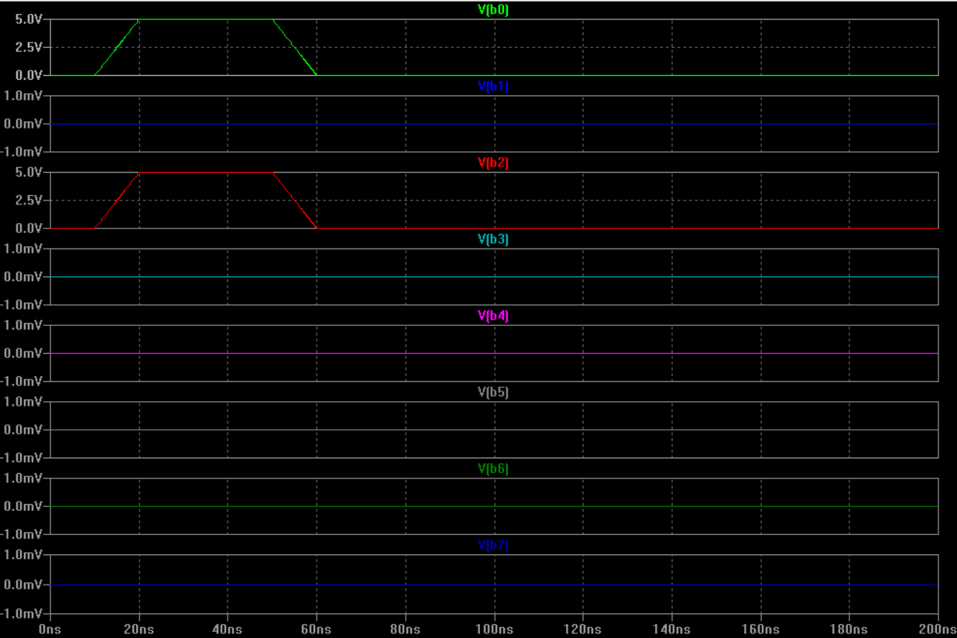
Demonstration of “Greater Than”
Last 2 digit of my Student ID in binary=> A = 01001110
B = 101
INPUT B

Slide 32
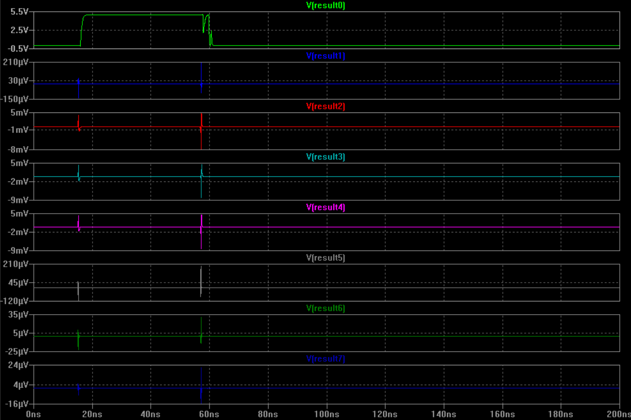
Demonstration of “Greater Than”
Last 2 digit of my Student ID in binary: A = 01001110
B = 101
Opcode | Operation | Expected Answer | Result of the simulation
1010 | A > B | 00000001 | 00000001
The greater-than operation is determined using the subtraction result. When Cout = 1, it indicates that A ≥ B. The Zero Flag is used to distinguish equality, and the Greater output is asserted only when Cout = 1 and Zero = 0. For this operation, only Result[0] is used, while all other result bits are tied to ground.

Slide 33
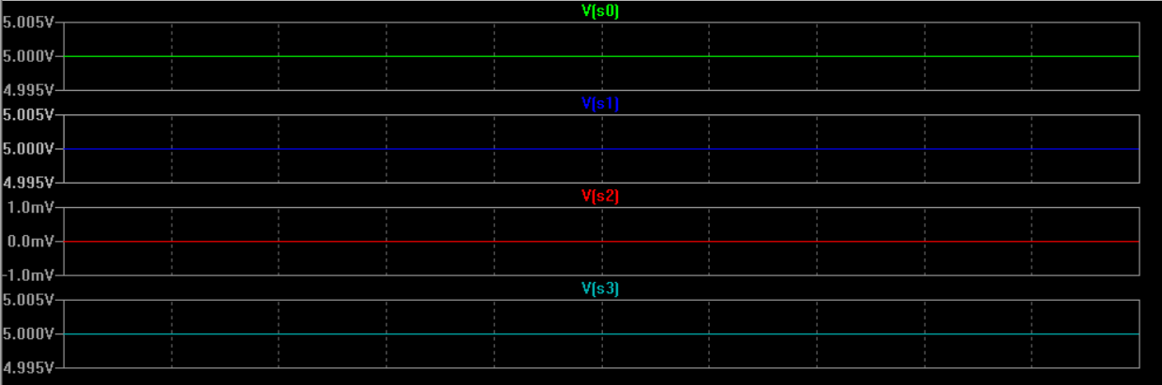
Demonstration of “Less Than”
Last 2 digit of my Student ID in binary: A = 01001110
B = 101
Opcode | Operation | Expected Answer | Result of the simulation
1011 | A < B | 00000000 | 00000000

Slide 34
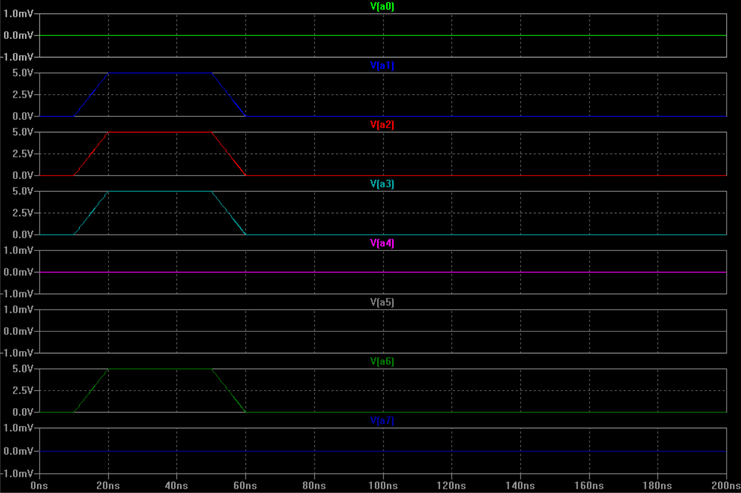
Demonstration of “Less Than”
Last 2 digit of my Student ID in binary: A = 01001110
B = 101
INPUT A

Slide 35
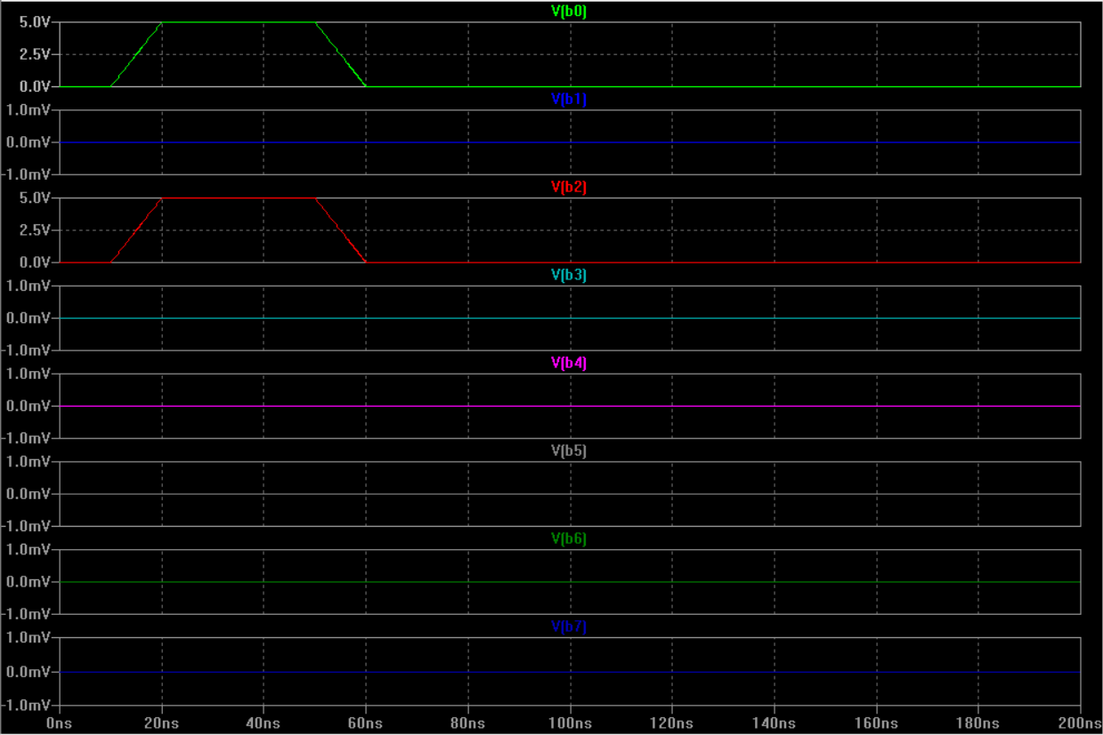
Demonstration of “Less Than”
Last 2 digit of my Student ID in binary: A = 01001110
B = 101
INPUT B

Slide 36
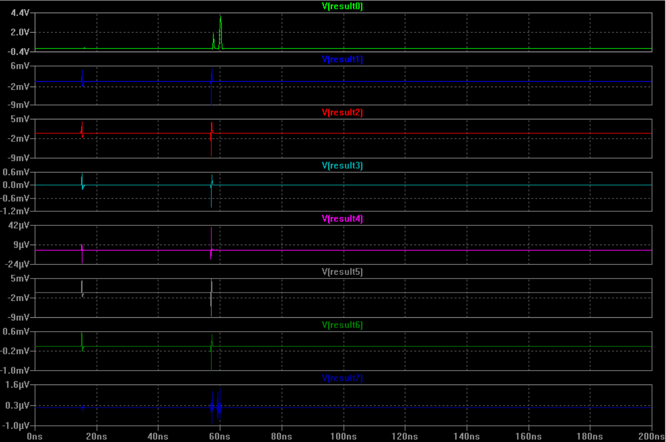
Demonstration of “Less Than”
Last 2 digit of my Student ID in binary: A = 01001110
B = 101
Opcode | Operation | Expected Answer | Result of the simulation
1011 | A < B | 00000000 | 00000000
The less-than operation is evaluated using the subtraction result. Since A > B, no borrow occurs and the Less condition is false. Therefore, the output remains 0, and only Result[0] is used while the remaining bits are tied to ground.

Slide 37
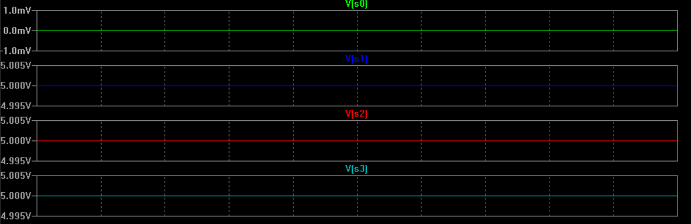
Demonstration of “Arithmetic left shift”
Last 2 digit of my Student ID in binary: A = 01001110 <<<1
Opcode | Operation | Expected Answer | Result of the simulation
1110 | A <<< B | 10011100 | 10011100

Slide 38
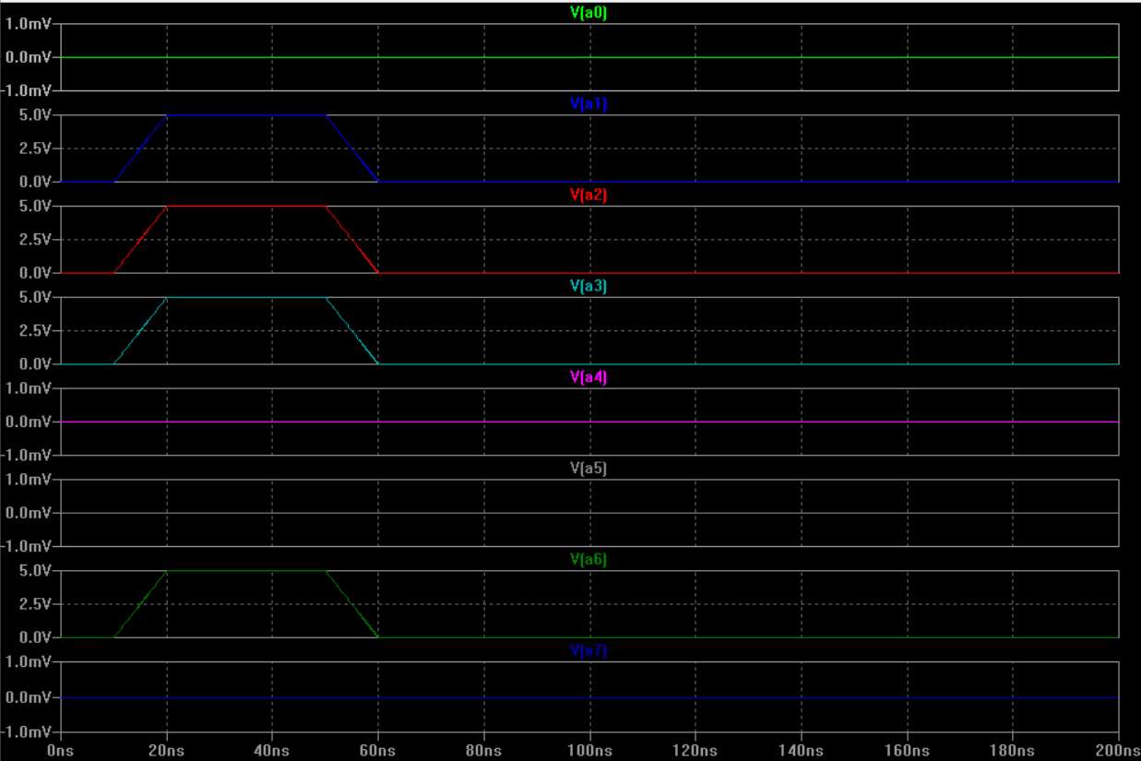
Demonstration of “Arithmetic left shift”
Last 2 digit of my Student ID in binary: A = 01001110 <<<1
INPUT A

Slide 39
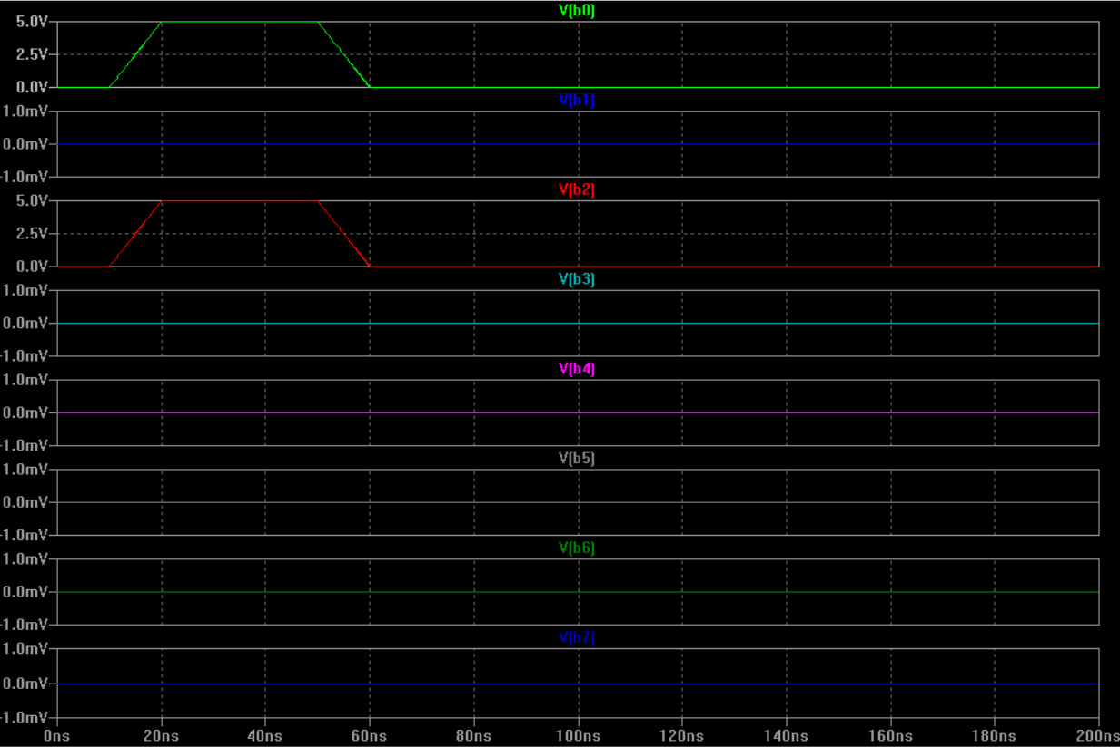
Demonstration of “Arithmetic left shift”
Last 2 digit of my Student ID in binary: A = 01001110 <<<1
INPUT B

Slide 40
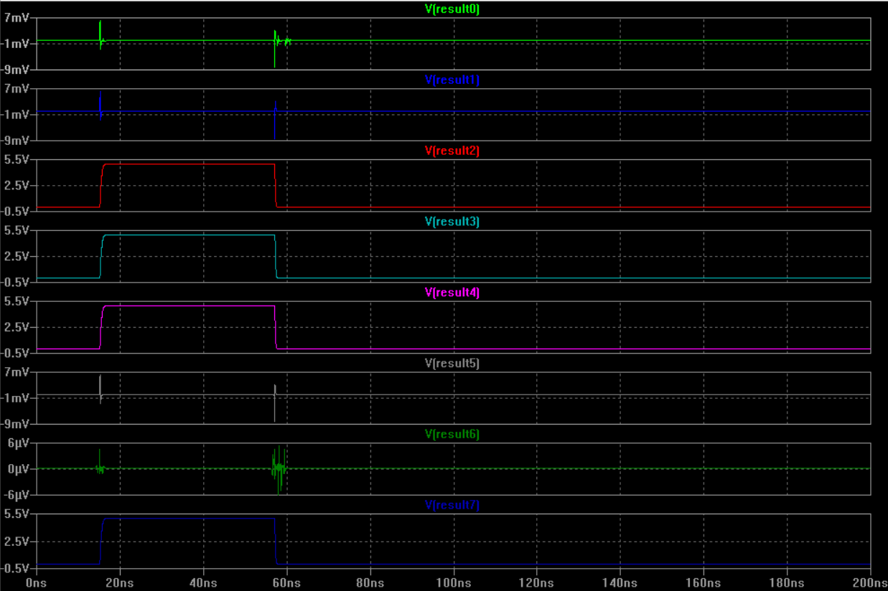
Demonstration of “Arithmetic left shift”
Last 2 digit of my Student ID in binary: A = 01001110 <<<1
Opcode | Operation | Expected Answer | Result of the simulation
1110 | A <<< B | 10011100 | 10011100
The arithmetic left shift operation shifts all bits of the input one position to the left. The least significant bit is filled with zero, while the most significant bit is discarded. In this case, shifting A = 01001110 left by one position results in 10011100, which matches the simulation output.

Slide 41
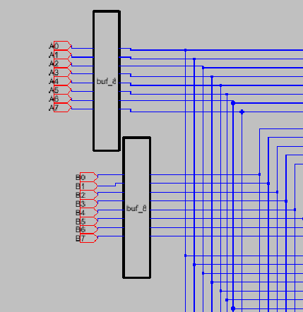
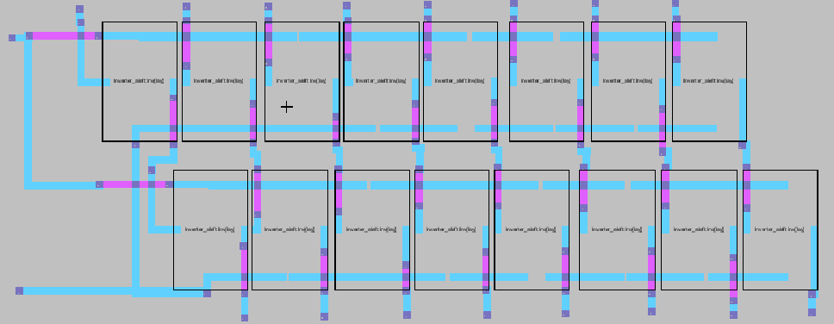
Demonstration of Novel Approach
In this 8-bit ALU design, input buffers were inserted at the A[7:0], B[7:0], and Opcode[3:0] interfaces to isolate external sources from the internal CMOS logic. Buffering improved signal integrity by reducing loading effects, preventing unstable transitions caused by large fan-out, and ensuring that the same clean logic levels are distributed consistently to all functional blocks. This approach increased the robustness of the full datapath because each subsequent block (adder, logic network, shifters, comparator/flags, and multiplexing tree) receives restored, full-swing signals rather than directly driving large internal capacitances from the input pins.
8-Bit Buffer Layout

Slide 42
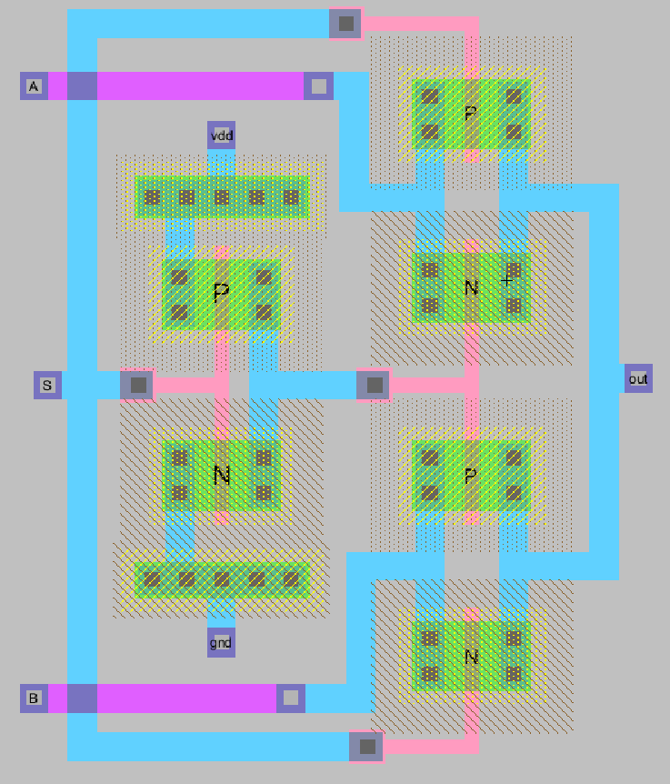
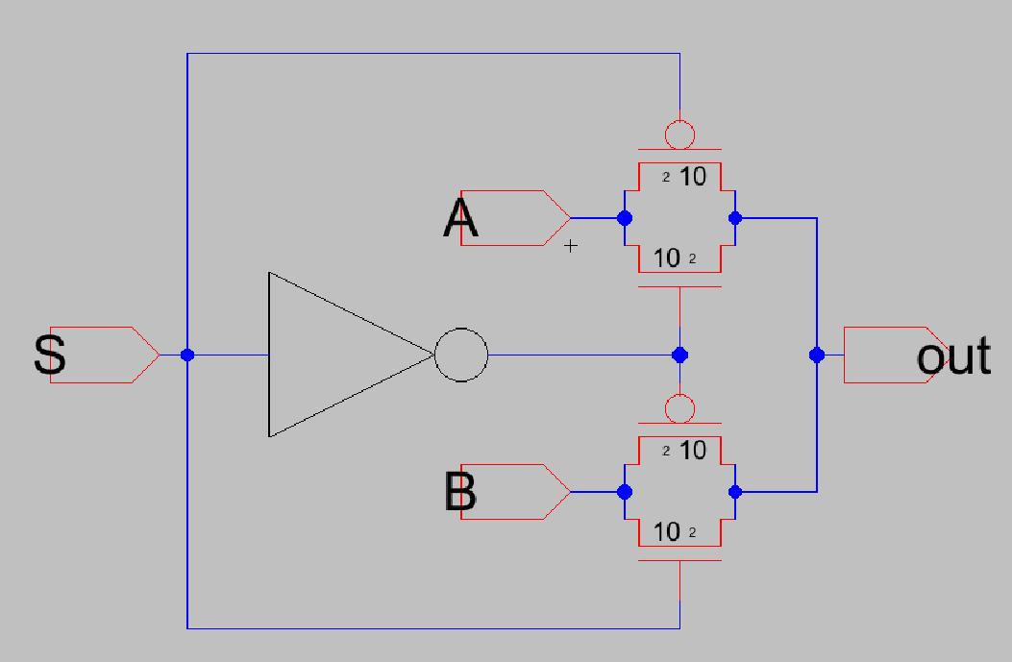
Demonstration of Novel Approach
A key novel choice in the selection network was implementing the 2:1 MUX using transmission gates (TG) instead of a conventional static CMOS gate-level MUX. A typical static CMOS 2:1 multiplexer can require a relatively high transistor count (commonly around ~20 transistors depending on the exact implementation), while a TG-based 2:1 MUX can be realized with only two transmission gates (4 transistors total) plus the required complementary select signal. This substantially reduced transistor count and routing complexity in the opcode selection structure, leading to a noticeable area advantage in layout, especially because multiplexing is repeated many times across an 8-bit datapath.

Slide 43
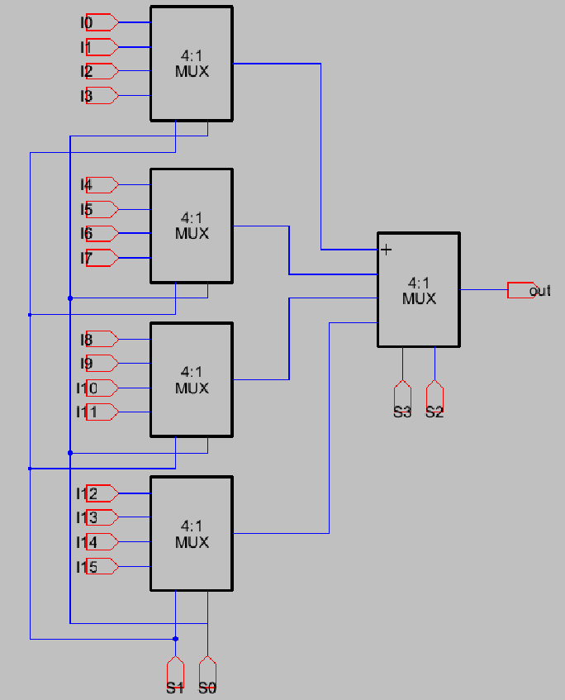
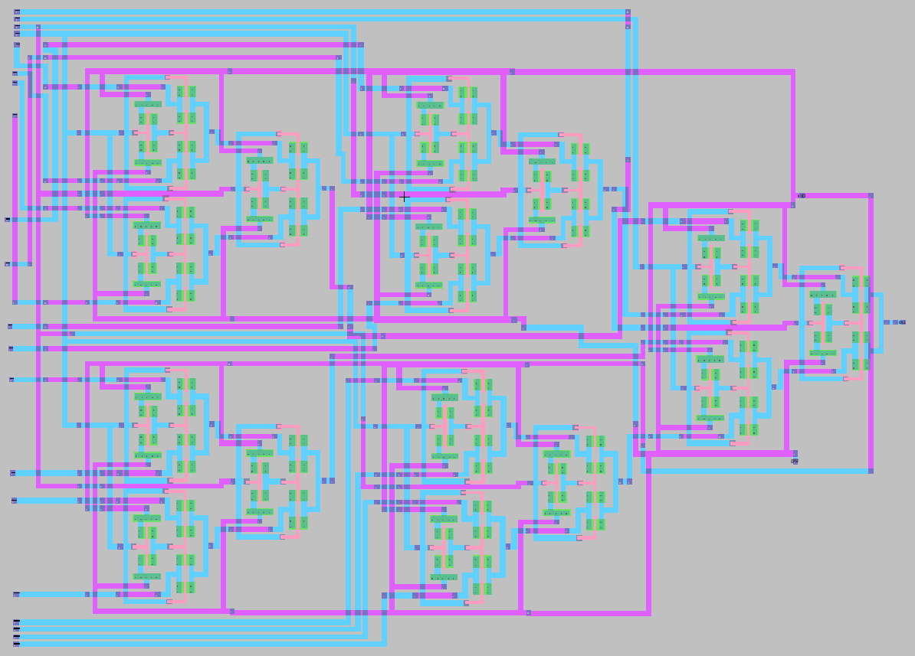
Demonstration of Novel Approach
To scale the opcode selection for a 16-operation ALU, the multiplexer network was built hierarchically. Instead of building a flat 16:1 directly, I first created reusable 2:1 MUX cells, then combined them into 4:1 MUX modules, and finally constructed the 16:1 selection by composing these 4:1 blocks. This modular hierarchy reduced design risk, simplified verification, and allowed layout reuse—each level (2:1 → 4:1 → 16:1) was validated in schematic and simulation before integration into the top-level ALU.

Slide 44
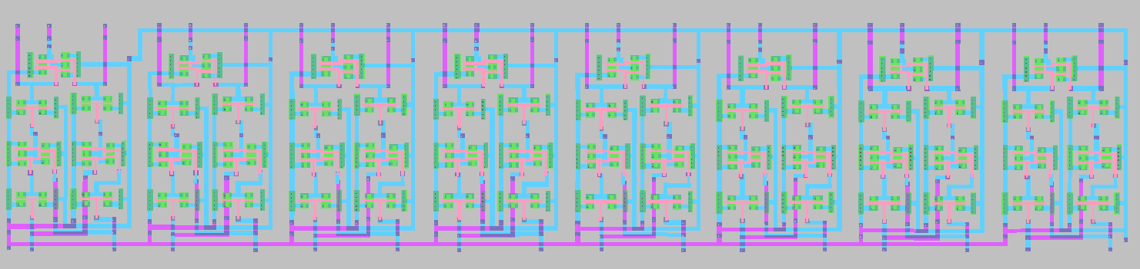
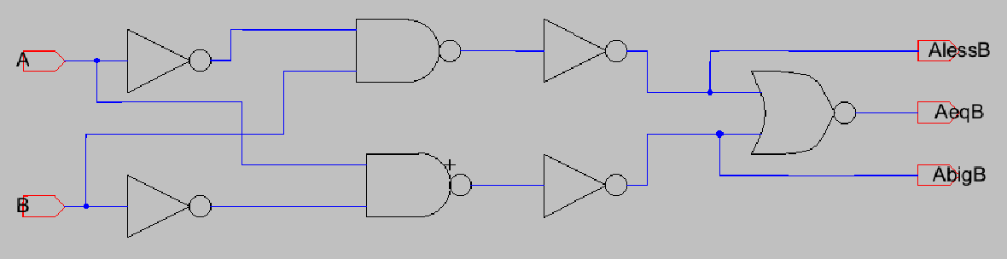
Demonstration of Novel Approach
For the comparison operations, I initially designed a 1-bit comparator cell and then replicated it to form an 8-bit version. After testing, I observed that this structure effectively performs bit-by-bit comparison, but it does not always produce a correct full-number comparison unless it includes proper MSB-to-LSB priority (cascading) logic. To correct this, I redesigned the comparison approach by reusing the subtractor output already present in the ALU. In the final implementation, equality is detected through a Zero flag derived from the subtraction result (A − B = 0), while greater-than/less-than are derived from subtraction-related flags (carry/borrow and/or sign behavior depending on the chosen convention). This eliminated the need for a dedicated multi-bit comparator chain and made the design both more correct logically and more area-efficient.
1-Bit Comparator
8-Bit Comparator

Slide 45
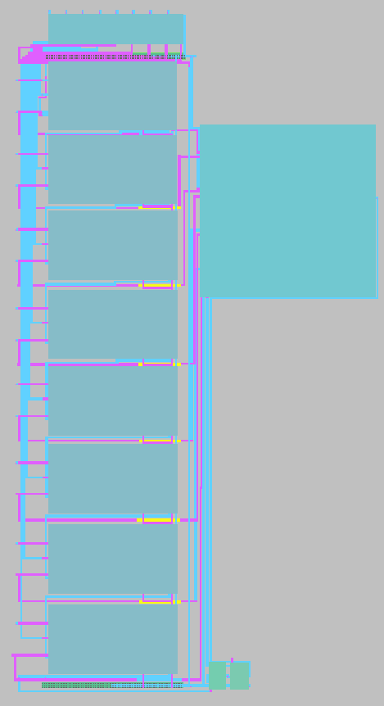
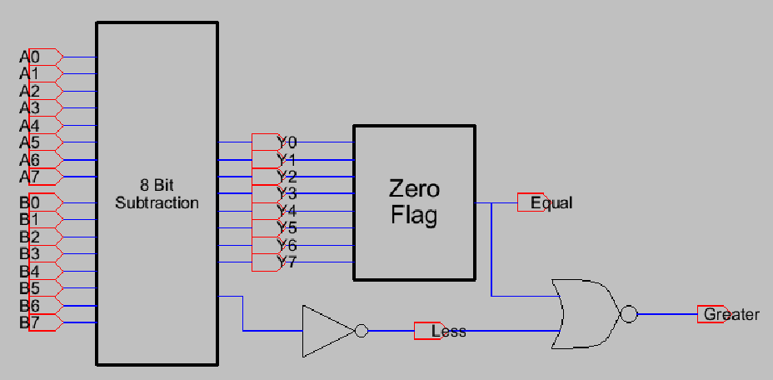
Demonstration of Novel Approach
As a result, subtraction and all comparison operations were consolidated into a single shared arithmetic path: one subtractor simultaneously supports A − B, A == B, A > B, and A < B through flag logic. This method reduces hardware duplication, improves resource utilization, and keeps the layout compact because it leverages circuitry that already exists for arithmetic operations rather than adding a separate comparator network.

Slide 46
Demonstration of Novel Approach
Finally, the entire ALU was developed using a fully modular design methodology. Every function was created first as a 1-bit building block, then extended into an 8-bit module, and each module includes its own schematic, layout, and icon for clean hierarchical integration. This modular flow made debugging and verification significantly easier, enabled layout reuse, and ensured that the final 8-bit ALU is structured as a scalable library of reusable CMOS macros.

Slide 47
Conclusion
In this project, a complete CMOS-based 8-bit Arithmetic Logic Unit (ALU) was designed and verified at the transistor level. Out of the sixteen required operations, fifteen were successfully implemented and validated. The only operation not implemented was the multiplication, which was excluded due to time constraints and its relatively higher structural complexity compared to the other operations.
Each functional block of the ALU was designed in a modular manner, starting from fundamental 1-bit building blocks and scaling up to 8-bit implementations. All major components were individually designed, simulated, and verified. For every operation, separate schematic and layout implementations were completed, ensuring correctness at the transistor level.
Although the complete 8-bit ALU layout integrating all functional blocks into a single top-level layout could not be finalized within the available time, the entire ALU was fully verified at the schematic level. Functional simulations confirmed that all implemented operations behave correctly and produce the expected outputs for all tested input combinations. The modular nature of the design ensures that the finalized 8-bit layout can be completed straightforwardly by assembling the already verified sub-blocks.
Overall, the project successfully demonstrates a full-custom CMOS ALU design methodology, including logic design, hierarchical structuring, transistor-level optimization, and functional verification. The resulting work provides a solid and extensible foundation for future enhancements such as full layout integration, timing optimization, and power analysis.

